Slide 1
Finite fields
A finite set of numbers
2 operations: + and * (defined in a customized manner)
F11 = {0, 1, 2, 3, 4, 5, 6, 7, 8, 9, 10}
Closed
If a and b are in the set
a + b and a * b are in the set
Additive identity
0 exists and has the property a + 0 = a
Multiplicative identity
1 exists and has the property a * 1 = a
Additive inverse
If a is in the set, -a is in the set
a + (-a) = 0
Multiplicative inverse
If a is in the set, a^(-1) is in the set
a * a^(-1) = 1

Slide 2
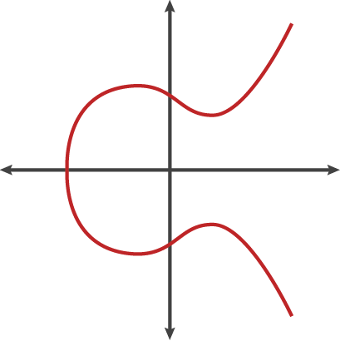
Eclipse curve
y^2 = x^3 + a*x + b
Point(x, y, a, b)
Bitcoin: y^2 = x^3 + 7, where a = 0, and b = 7
A + (-A) = I
I means infinity
C
B
A
A
A
-A
A + B
A + A

Slide 3
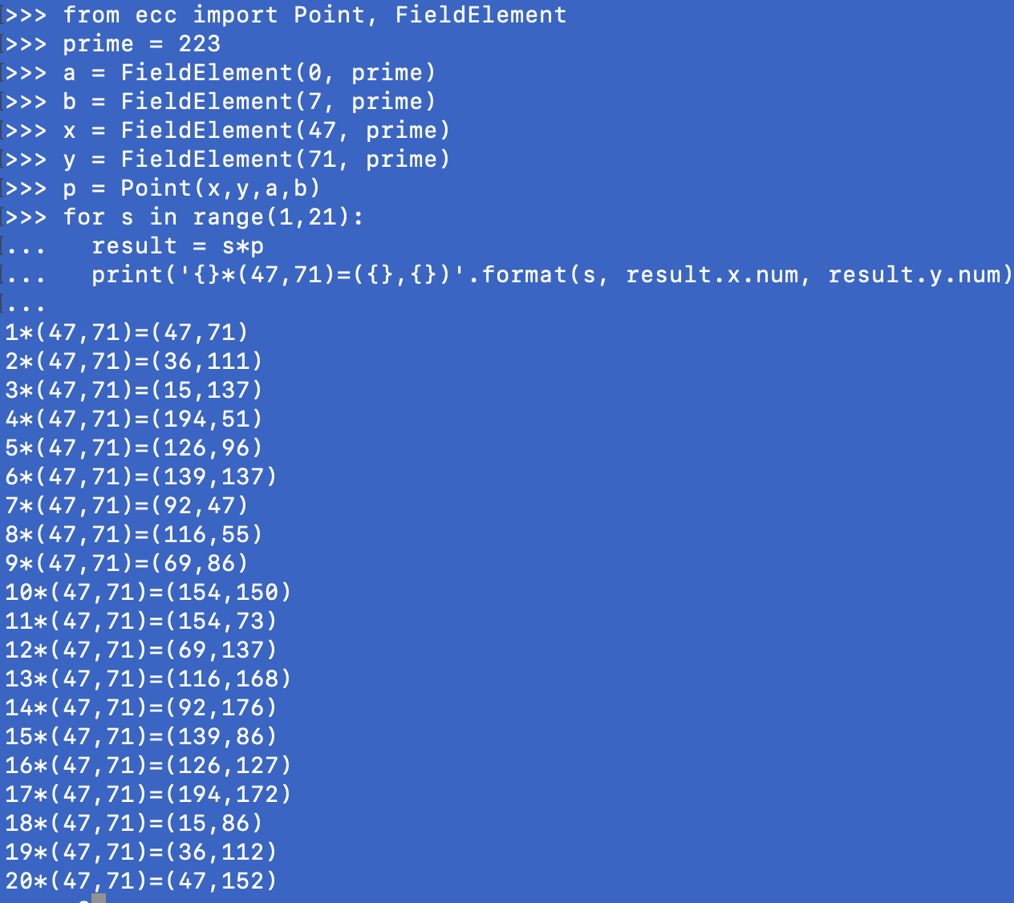
Eclipse curve cryptography
XXXX
eG = P
a and b of the curve
the curve
y^2 = x^3 + a*x +b
prime of the finite filed
the finite filed
{0,1,2,3,4,…p-1}
x and y coordinates of the generator point G
the generator point
(x, y), the generator point G
the order of the group generated by G, n
order of the group
{G, 2G, 3G, 4G, … nG} where nG=0 (ininity)

Slide 4
Eclipse curve cryptography
再引入两个新的参数
z
r
首先，eG = P, 其中，e为private key，P为public key，G为比特币的常量，起点值。已知G和e，很容易计算P。但是已经P和G，无法计算e
随机给出一个k, 使kG = R
引入两个参数：uG + vP = kG
因为eG = P，可以知道：
u =
v =
s
s
其中，z代表 purpose of the shooting
r代表，R的x坐标值
s可以推算：
z + re
s =
k
k - u
G
= P
v
e G
= P
在验证时，private key的拥有者给验证者两个值，(r, s)，以及z。如果计算出的R的x坐标与r相等，证明他确实拥有正确的u和v值，即拥有e
k - u
k是随机数。通过知道P和G, 无法反推出，
只有当知道e的时候，才能得到正确的（u，v）组合。因此，如果一个人能够给出正确的（u，v）组合，就代表它知道e，知道private key
v

Slide 5
Serialization
Encode (r,s), public key for transmission purpose

Slide 6
Eclipse curve
XXXX

Slide 7
Eclipse curve
XXXX

Slide 8
Eclipse curve
XXXX

Slide 9
Eclipse curve
XXXX

Slide 10
Eclipse curve
XXXX

